Slide 1






Video Compression (Group 22)
Arun kumar MT24019
Ashish Mishra MT24020
Shriyansh Bhardwaj MT24090
Shraddha Choudhary MT24086
1

Slide 2
Introduction
Video compression reduces file size while maintaining quality
This project explores video properties, compression techniques, and EDA.
Focus :
ML-based compression pipeline, analyzing video frames and motion
Problem Statement
The growth of high-resolution video content and the increasing demand for efficient video storage and transmission have made video compression an essential aspect of modern multimedia technology.
2

Slide 3
Video Dataset
Frame Count: 14,291 frames
Frame Rate: 23.81 fps
Duration: 600.22 seconds (~10 minutes)
Resolution: 1920x800 pixels
Codec: HEVC (High-Efficiency Video Coding)
Purpose: The dataset provides a detailed overview of the video content and characteristics for effective compression.
3

Slide 4
Exploratory Data Analysis
Goal of EDA:
Understand video properties (motion, scenes, color distribution).
Identify areas for compression optimization.
Key Areas of Focus:
Frame Sampling and Visualization
Histogram Analysis of Color Distribution
Edge Detection and Motion Analysis
Scene Change Detection
Foreground Detection Using Background Subtraction
4

Slide 5
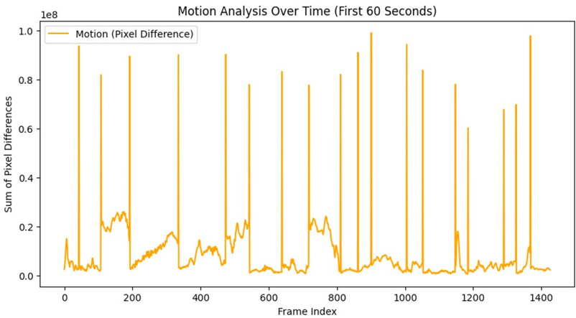
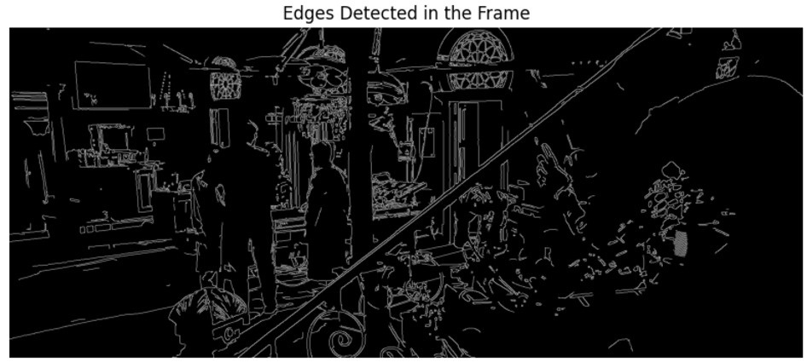
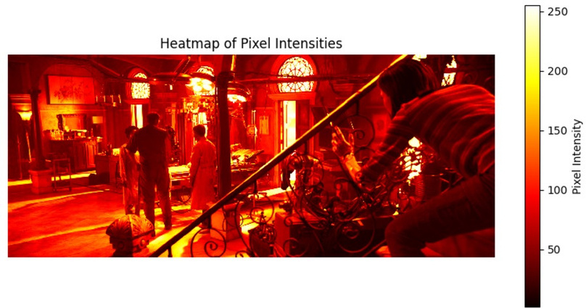
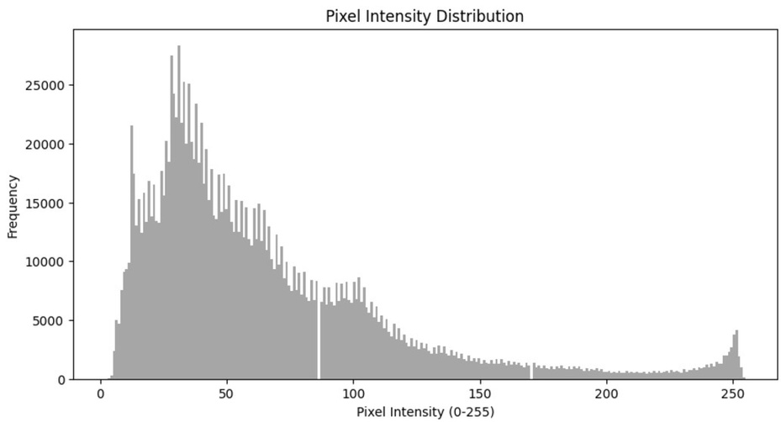
EDA Result
Motion Analysis
Edge Detection
5
Heatmap
Pixel Intensity distribution

Slide 6
Methodology
Keyframe Extraction
Optical Flow
Histogram Difference between 2 key-frames
Filling gaps in keyframes
Compression
Decompression
6

Slide 7
Techniques Used
Optical flow is a technique used to calculate motion between two consecutive frames in a video. This technique uses pixel intensity values and calculates motion vectors that represent the movement of objects in the scene. The method is implemented using OpenCV.
Histogram Difference: This technique compares the color histograms of two consecutive frames to identify significant changes. If the difference is above a certain threshold, a keyframe is selected. This method is useful in detecting scene changes and ensuring that keyframes are extracted at the correct moments.
Linear Interpolation: Linear interpolation is used to generate intermediate frames between keyframes. This involves interpolating pixel values from the two keyframes to create a new frame that lies between them.
7

Slide 8


Analysis and Evaluation
Metric: Compression Ratio.
For Alita_Battle.mkv: 2.59
For Avengers_Endgame.mkv: 4.87
Observations:
Efficient keyframe-based compression
Original Video Key frame
Frame generated by interpolation
8

Slide 9
Challenges and Future Work
Challenges:
Maintaining high visual fidelity with extreme compression
Computational overhead for interpolation
Explore advanced ML-based codecs
Future Improvements:
Use GANs for enhanced reconstruction
Include video’s audio compression
9

Slide 10
THANK YOU
10

